Slide 1
Claims of causality in health news: a randomised trial
aka
Why everything causes and cures cancer

Slide 2
Scientific results are often exaggerated in the media.
This might reflect an attitude of “exaggerate or perish” on the side of scientists,
or The need for media uptake on the side of journalists.

Slide 3



What exaggeration?
Headlines
U.K. Daily Mirror January 31, 2009
New York Daily News December 12, 2008
U.K. Daily Telegram September 11, 2008
U.K. Daily Mirror January 31, 2009
Content
Text changes correlation to causation, or effect magnitude.

Slide 4
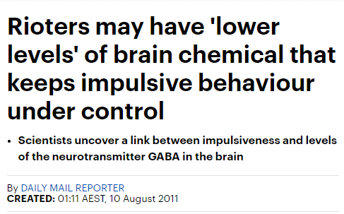
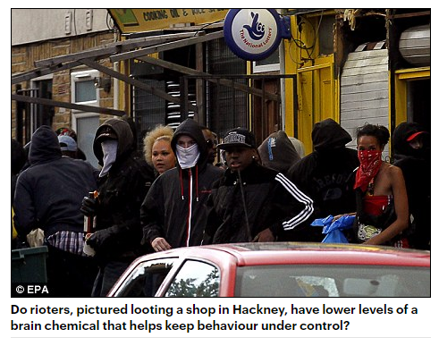
The story so far…
Newswire “Brain chemical lack 'spurs rioting’”
The Sun heralded: “A Nose spray to stop drunks and brawls”

Slide 5

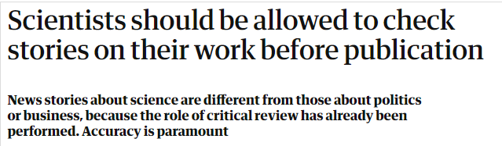
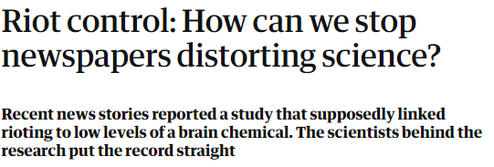
The story so far…
Reply piece: Dr Petroc Sumner, Dr Frédéric Boy, & Dr Chris Chambers
By Ananyo Bhattacharya Then chief online editor for Nature.
If anyone (including scientists) can veto what we publish, journalism dies.
Also, those exaggerated results…
“I ain’t do that.”

Slide 6
The story so far…
So, if Journalists do not exaggerate scientific results, why do exaggerated results persist in the media?

Slide 7
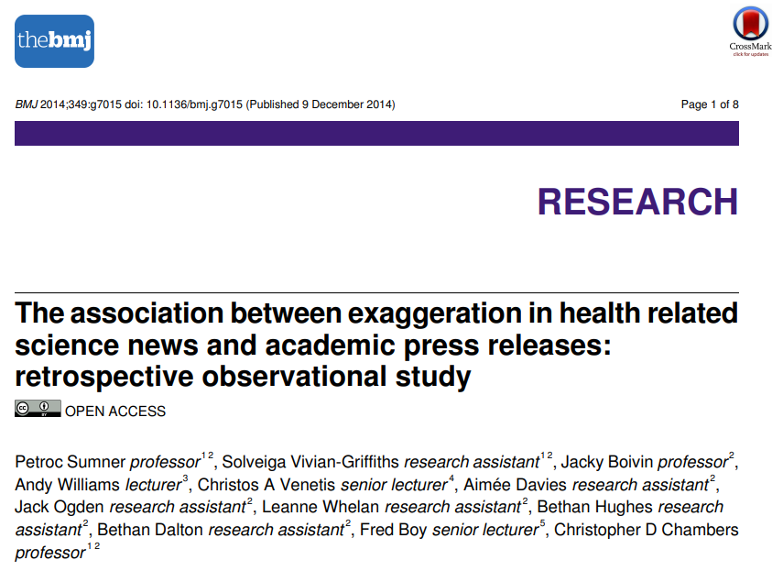
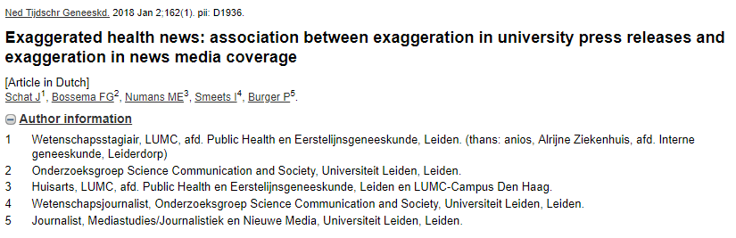

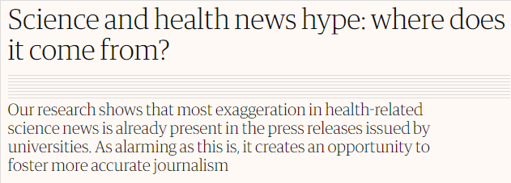
Exaggerated results stem from university press releases, not journalists.

Slide 8
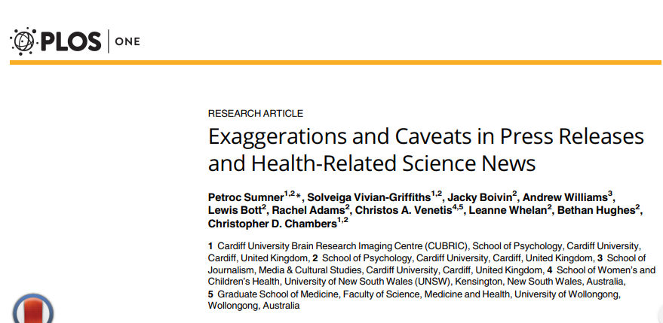

But is it just the Universities doing the dirty?
No. It’s scientific Journals too.

Slide 9
Key Questions
If exaggeration starts with the press release, would making the PR more accurate translate to the media?
Would a cautious PR impact the uptake of scientific results in the general public?

Slide 10
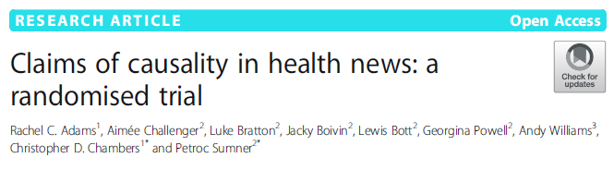
Todays Paper
“To operationalise evidence strength, we concentrated on the basic distinction between correlational and experimental types of evidence…focusing upon observational and experimental studies.”

Slide 11
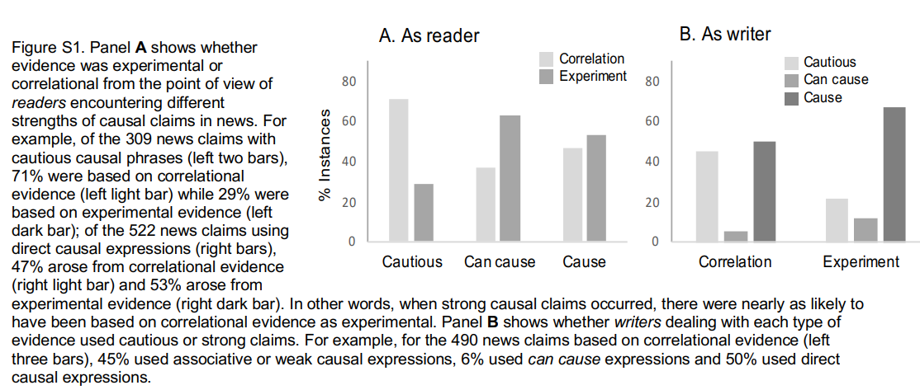
Todays Paper
“…strong causal claims were almost as likely to be based on correlational evidence as on experimental evidence” – Sup Materials

Slide 12
Todays Paper
Press Releases (N=312) were sent to the team prior to media release and were randomly allocated to one of four groups:
Control (PR = 89, News = 574)
Irrelevant change e.g., “beverage” changed to “drink”
(A) Causal claim alignment (64 PR, 517 News)
Headlines or content sentence -> e.g., change causal to associational/correlational.
(B) Causality statement (79 PR, 601 News)
“We do not know if wine is directly responsible for cancer risk.”
A + B (80 PR, 592 News)
News: Coverage of research = 7 days prior – 28 days post PR.
Assessed by researchers blind to the intervention.

Slide 13
Todays Paper
Measurement
ITT – intention to treat (as randomised).
Assesses effects in the absence of selection biases. Gold standard in many RCTs.
For example, non-adherence, misclassification, measurement problems, drop-out
Problem. Many PRs already included intervention A and/or B, possibly due to the previous publications (Sumner et al., 2016, 2014). If allocated to A/B, left unaltered.
AT – as treated.
Assesses effects relative to the intervention
GEE – generalised estimating equations to account for clustering of news to PR, or PR to press offices
¹McCoy, C. E. (2017). Understanding the intention-to-treat principle in randomized controlled trials. Western Journal of Emergency Medicine, 18(6), 1075.

Slide 14
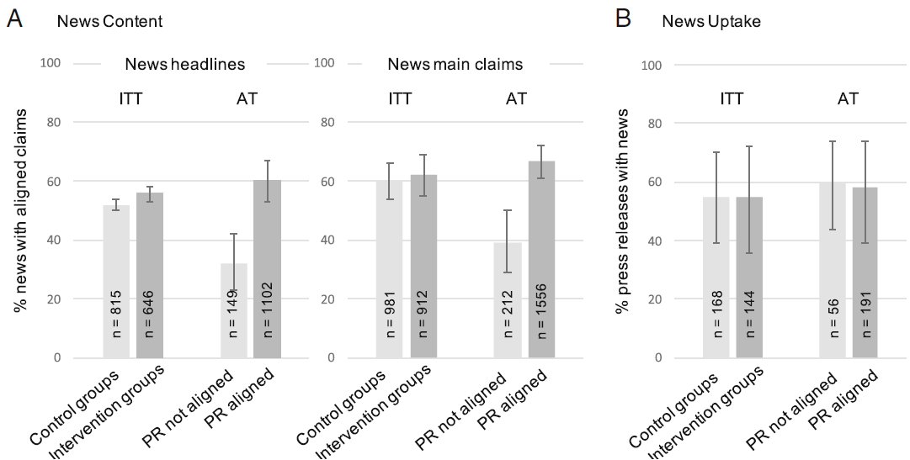
Todays Paper
*
*Possibly due to spontaneous adoption
AT analysis: Higher uptake of news for causality PR | observations studies only

Slide 15
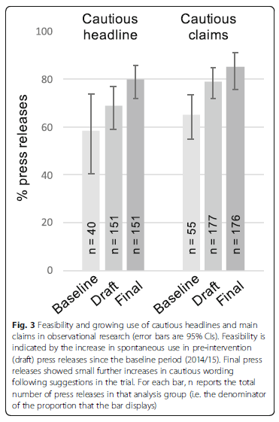
Todays Paper
Spontaneous adoption
10% in baseline period (2014/2015)
30% in draft period (during intervention)
59% intervention suggestions accepted

Slide 16
Todays Paper
Other interesting findings - Advice and animal-to-human claims
Rates of advice were similar across PR (22%) and news (27%). The odds of finding advice in news was 34 times higher (p < .001) if the advice was already in the PR. “Consumers should be advised that…”
Human claims from animal studies were uncommon in PR (0.5%) and news (2.2%). Odds of finding such a claim in the news were 143 times higher when the PR made an animal-to-human claim.

Slide 17
Conclusions
Statements of causality, for the vast majority, only occurred in the news when first in the PR.
20% of news explicitly stated whether causality can be inferred when prompted to do so by the PR. e.g., “We do not know if wine is directly responsible for cancer risk.”
Parallel research has found that caveats lead readers to rate researchers as less confident, without lowering interest (Bratton et al., 2019)

Slide 18
Conclusions
As scientists, we need to be careful with the claims that are published by our university and journal press releases
This procedure is pragmatic and has been shown to be effective.
It may also lead to spontaneous adoption by the wider media and press release offices.
Thanks

Slide 19
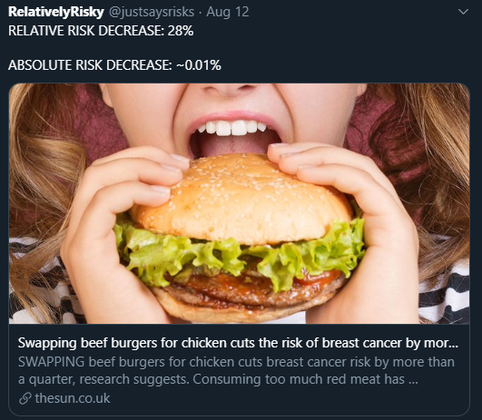
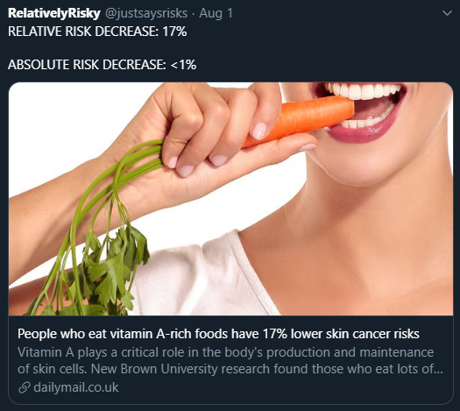
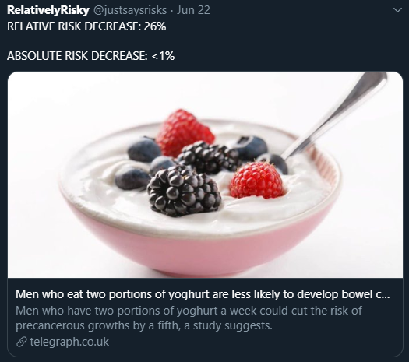
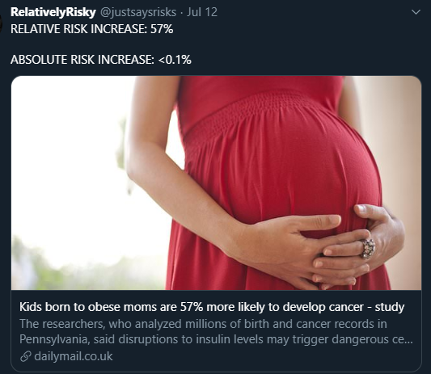
What next…Relative risk?

